Slide 1
Aero 625 Project
Modern Control of Aerospace Systems
Xingran Huang | ME Student

Slide 2
OVERVIEW
Model Choose
  F-16A Fighting Falcon, lat/d
  The reason why I selected this model due this model satisfy project requirements:
  - The plant is MIMO.
  - It has three states and two controls.
  - The aircraft designs look good.
Open-loop & Closed-loop Characteristics
  Eigenvalues, eigenvectors
  Frequencies
  Damping rations
  Time constants
  Check controllability and observability
Notes:
AS STATED ABOVE.

Slide 3
OVERVIEW
SDR Controller
PI-SDR Controller
NZSP Controller
PI_NZSP Controller
PFI-NZSP-CRW
Notes:
AS STATED ABOVE.

Slide 4
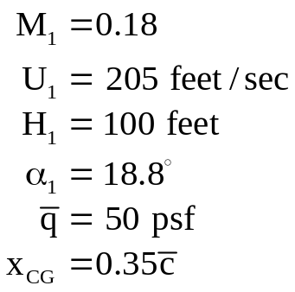
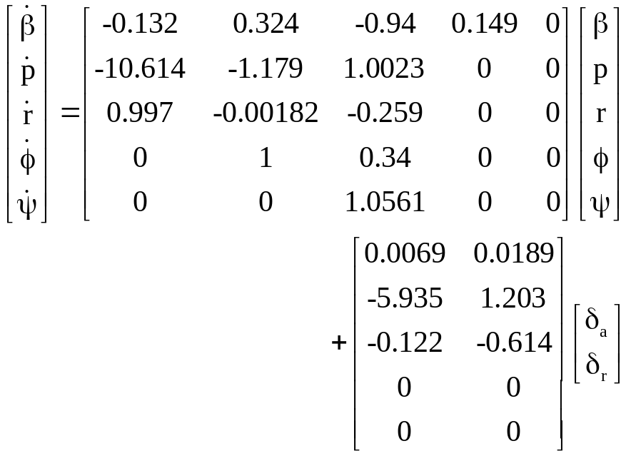

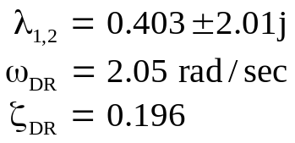
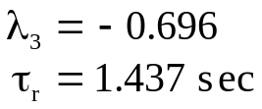
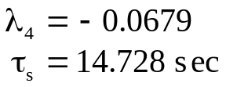
Model Choose
^{F-16A Fighting Falcon, lat/d}

Slide 5
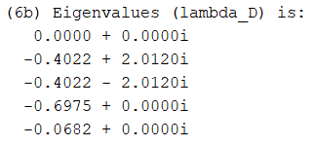
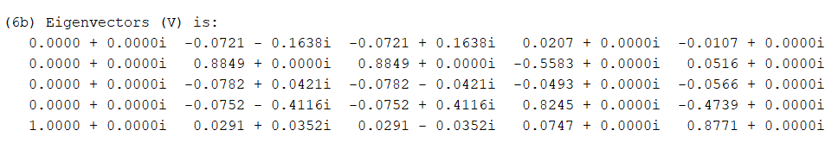
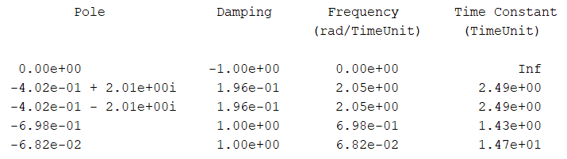
Open-loop Characteristics
^{F-16A Fighting Falcon, lat/d}

Slide 6
Open-loop Characteristics
^{F-16A Fighting Falcon, lat/d}
The system is controllable. Since the rank of the controllability matrix, Co is equal to the number of states in the state-space model.
The system is observable. Since the rank of the observability matrix ob is equal to the number of states in the state space model.
The system is reachable. Since A matrix of the discrete system is nonsingular. Determinant = 0.
The system is constructable. Since observability matrix is full rank.
Selection of sample period Ts is 1.531171e+00 s.

Slide 7
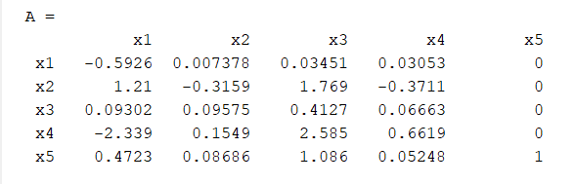
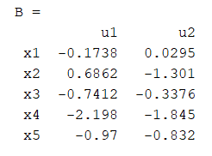
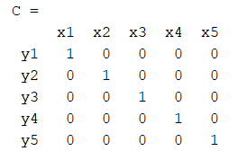
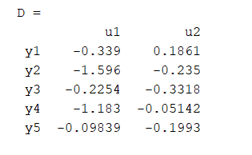

Open-loop Characteristics
^{F-16A Fighting Falcon, lat/d}
Convert the model from continuous to discrete time

Slide 8
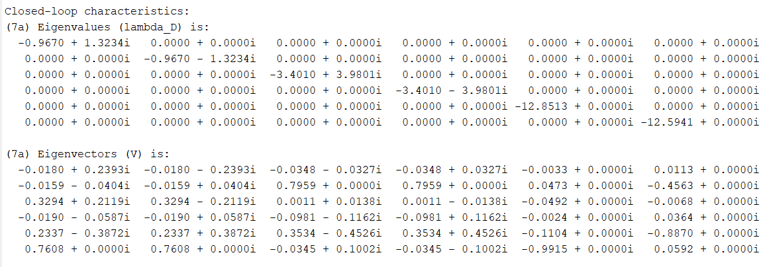
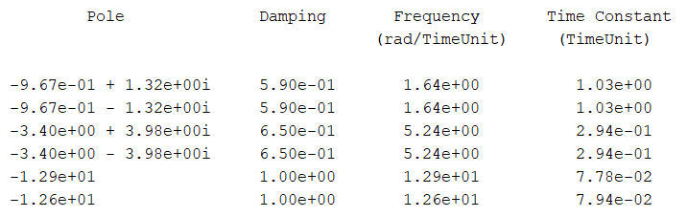
Closed-loop Characteristics
^{F-16A Fighting Falcon, lat/d}

Slide 9
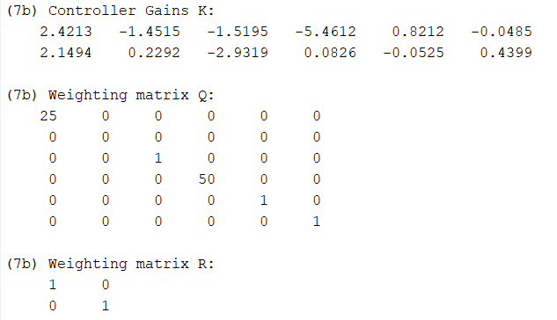
Controller gains & Weighting matrices
^{F-16A Fighting Falcon, lat/d}

Slide 10
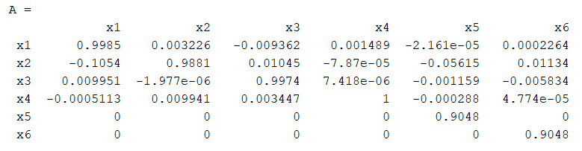
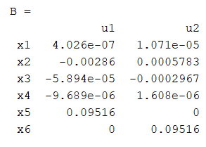
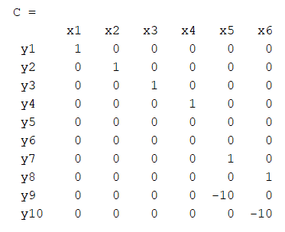
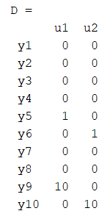

SDR Closed-loop Characteristics
^{F-16A Fighting Falcon, lat/d}
Convert the model from continuous to discrete time

Slide 11
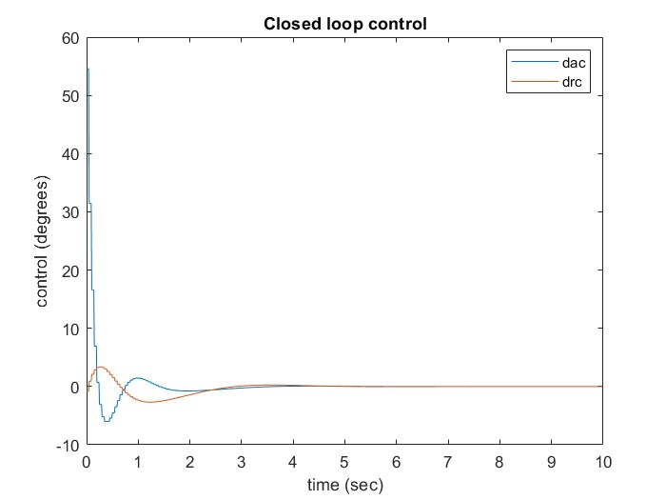
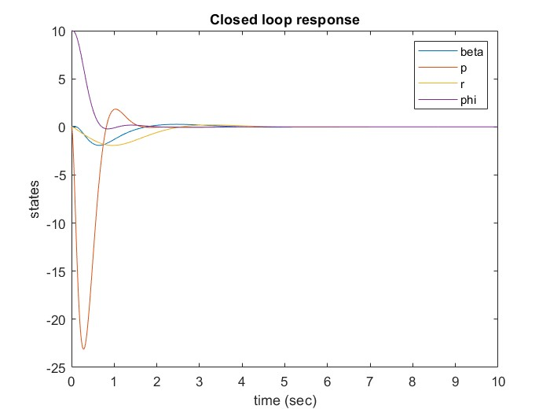
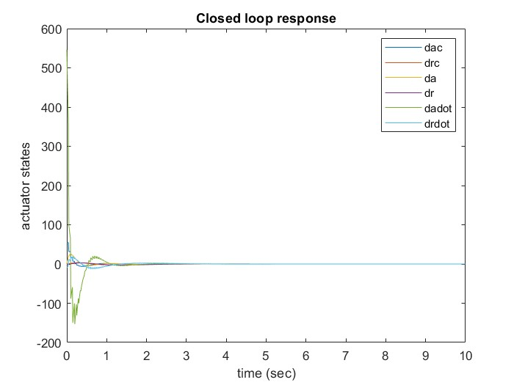
TR_Rise Time =
1.303355e+00
1.303355e+00
4.403632e-01
4.403632e-01
2.723459e-01
2.779076e-01 seconds.
TS_Settling Time is
4.136429e+00
4.136429e+00
1.295041e+00
1.176131e+00
3.112525e-01
3.176087e-01 seconds.

Slide 12
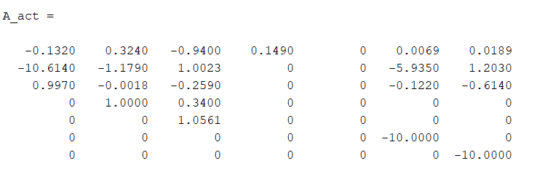
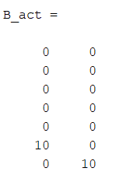
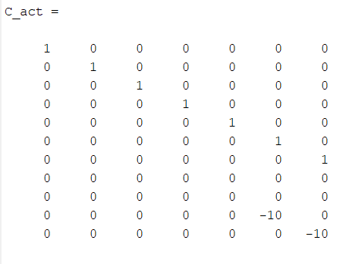
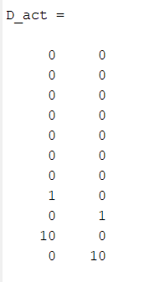
Add actuator dynamics to the overall system
Establish a new system

Slide 13
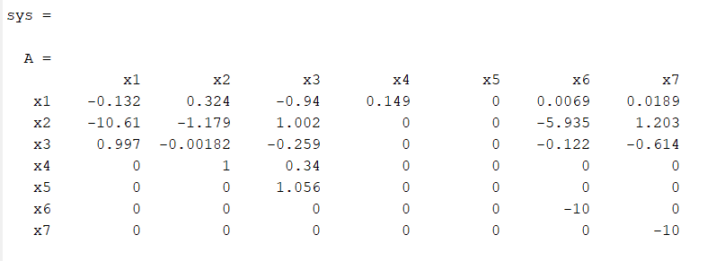
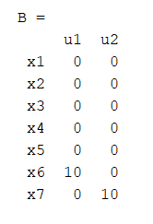
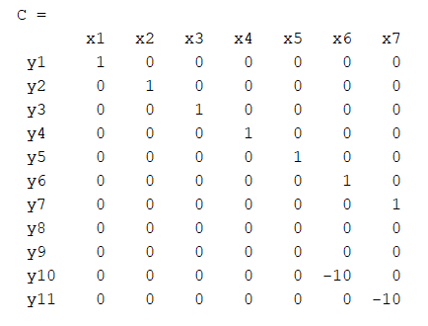
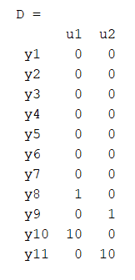
Add actuator dynamics to the overall system
Establish a new system

Slide 14
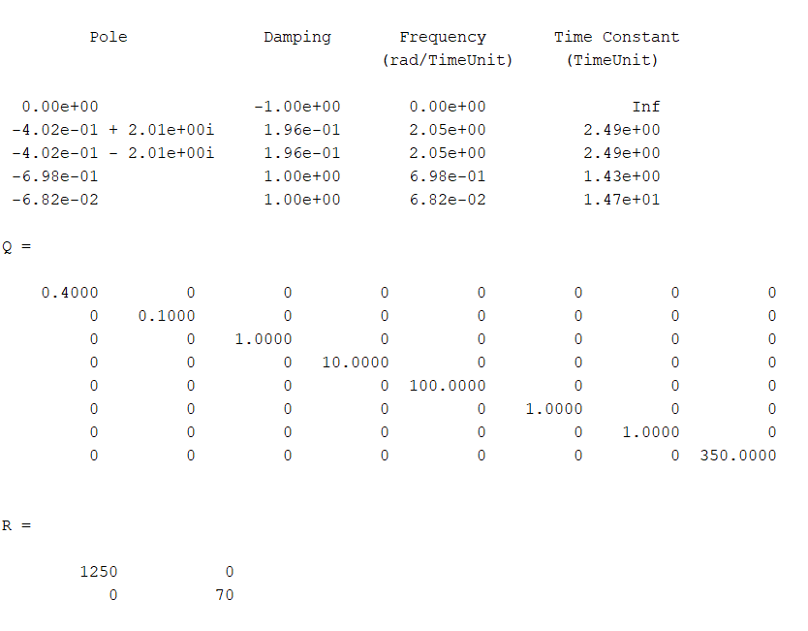
PI-SDR Controller

Slide 15
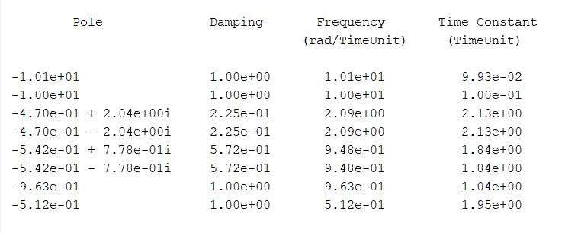
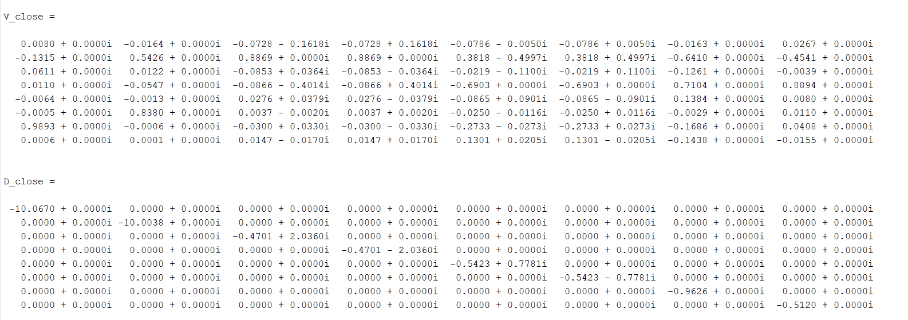
PI-SDR Controller

Slide 16
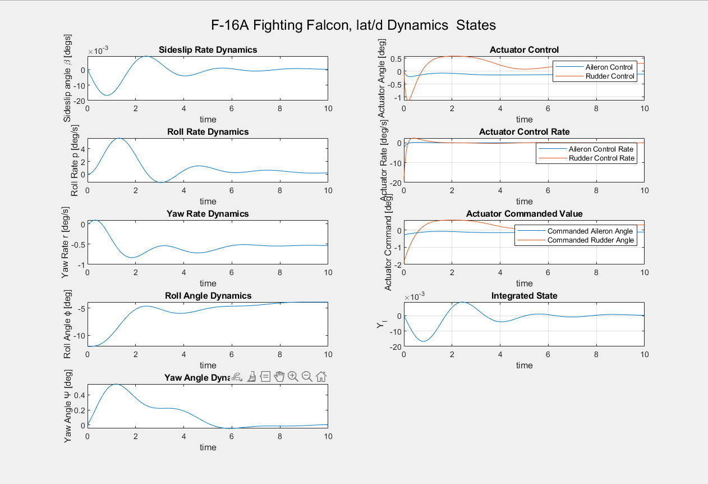
PI-SDR Controller

Slide 17
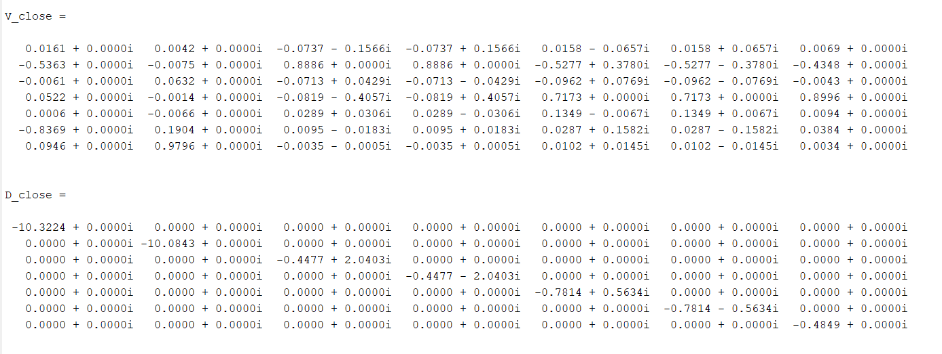
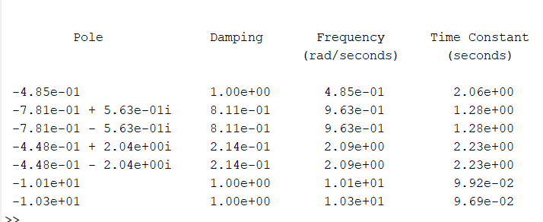
NZSP Controller

Slide 18
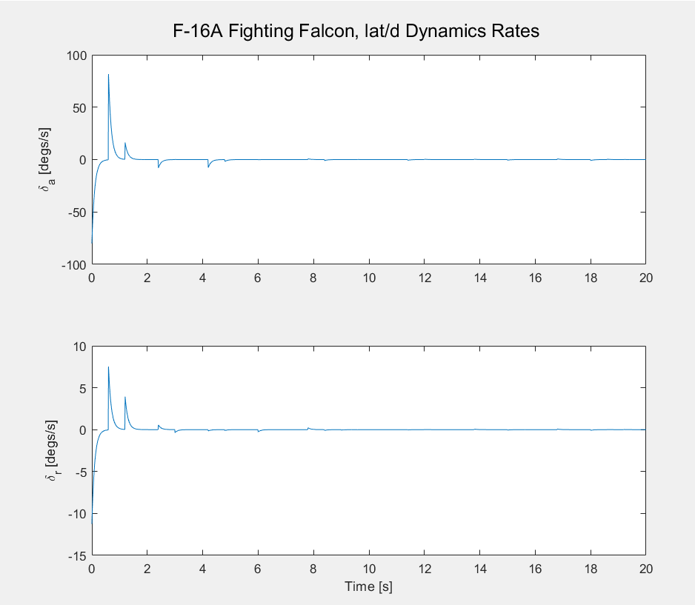
NZSP Controller

Slide 19
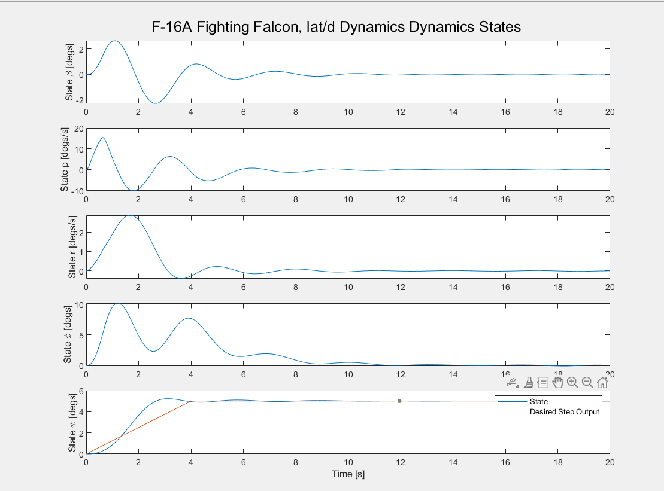
NZSP Controller

Slide 20
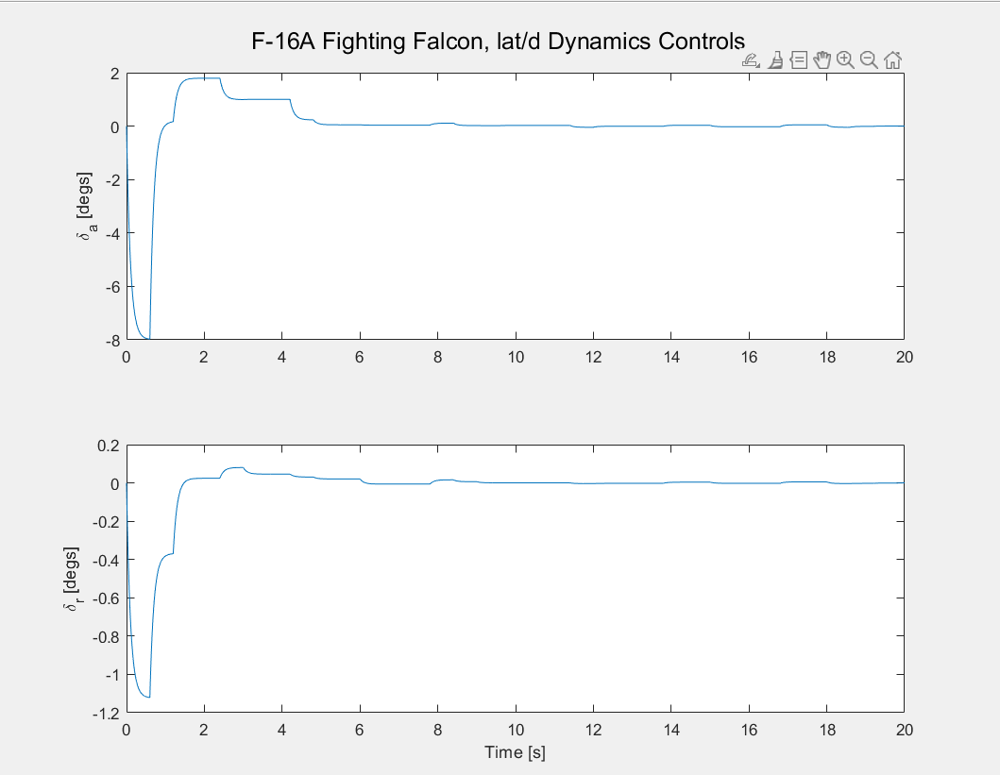
NZSP Controller

Slide 21
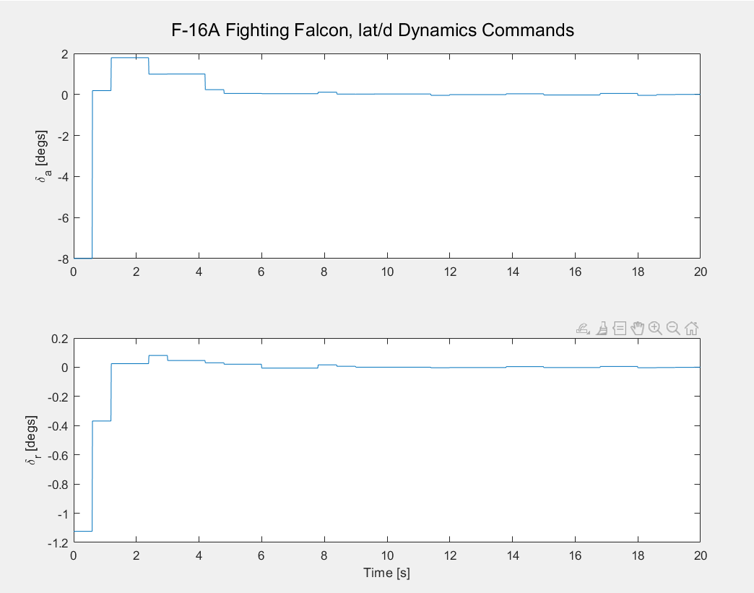
NZSP Controller

Slide 22
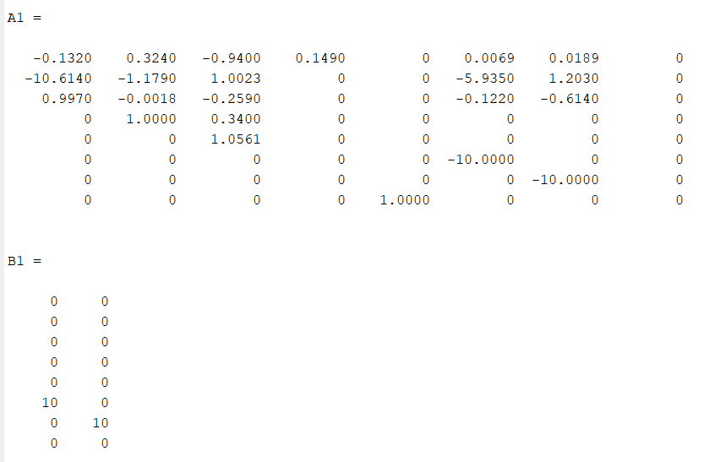
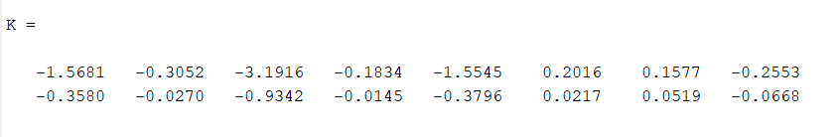
PI-NZSP Controller

Slide 23
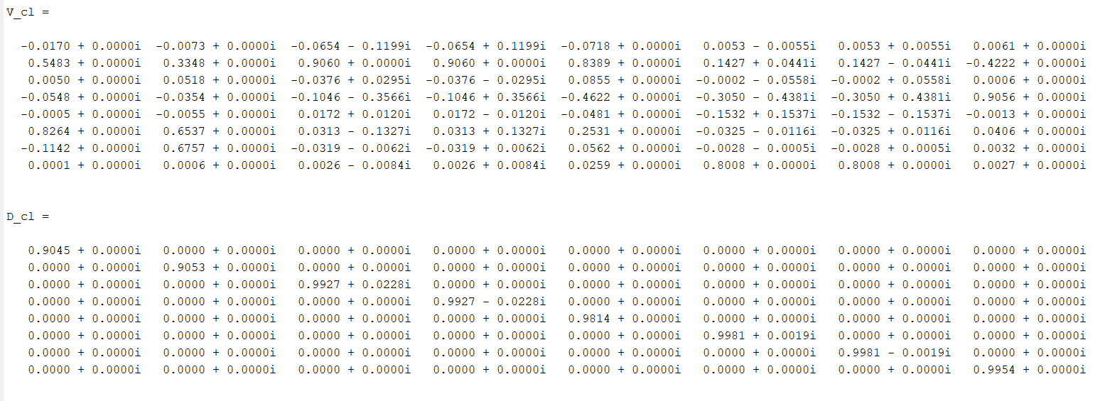
PI-NZSP Controller

Slide 24
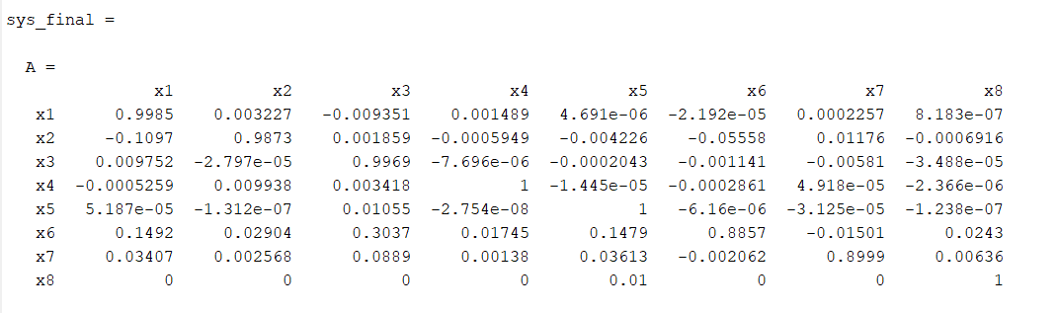
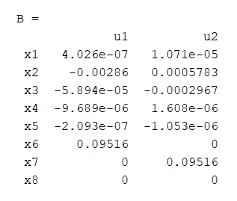
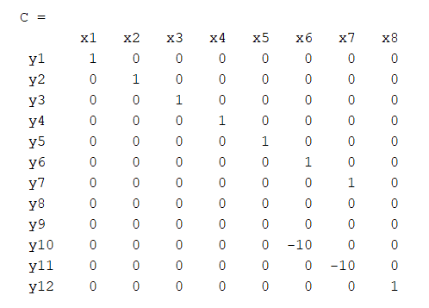
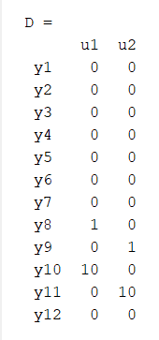
PI-NZSP Controller

Slide 25
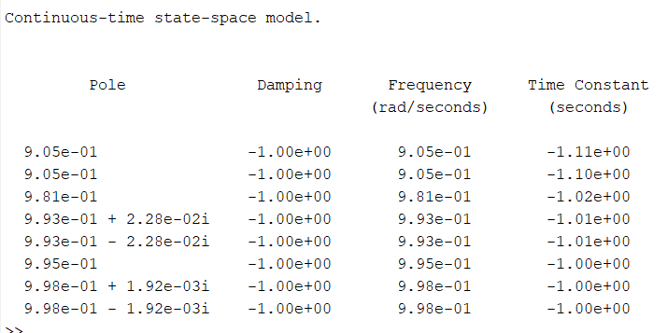
PI-NZSP Controller

Slide 26
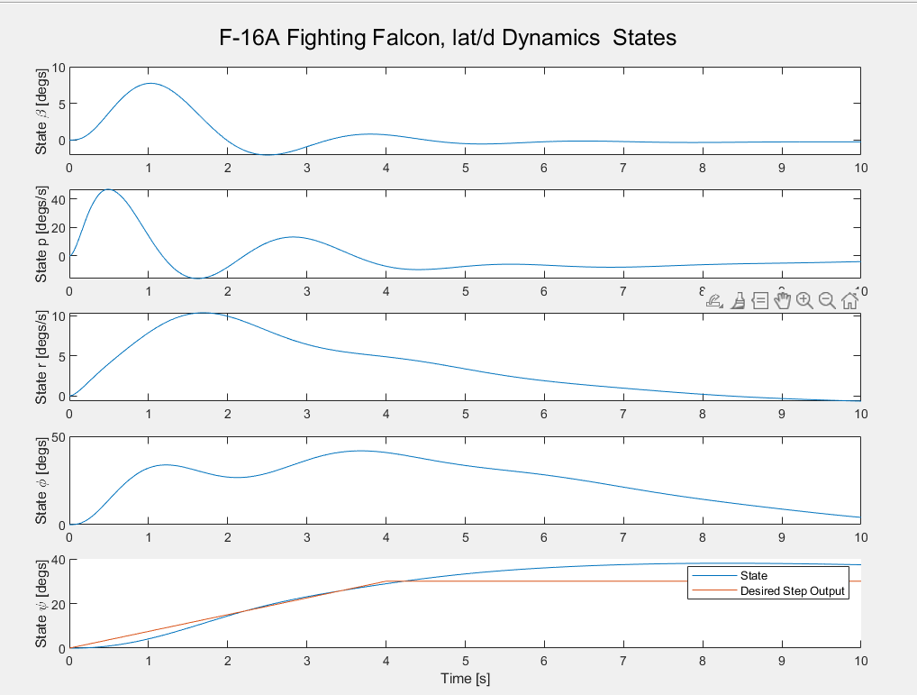
PI-NZSP Controller

Slide 27
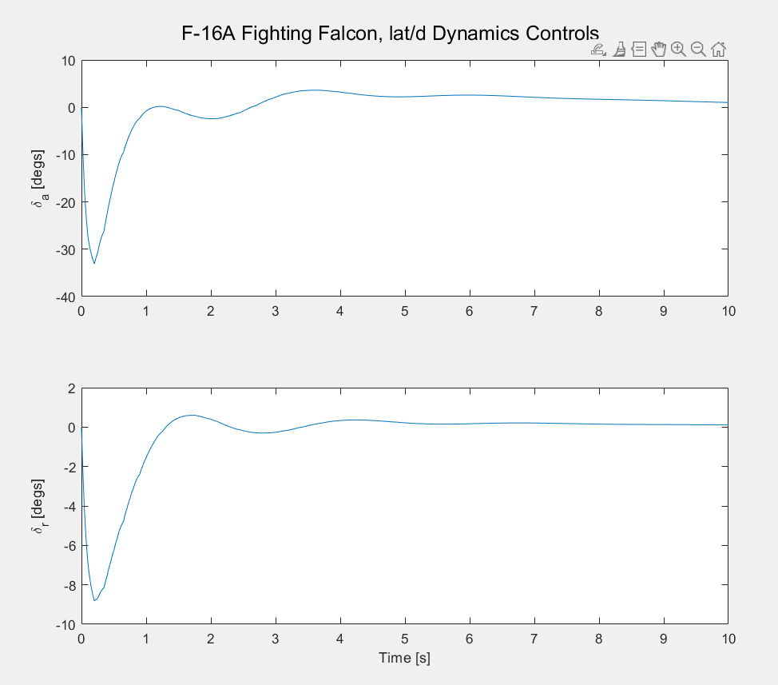
PI-NZSP Controller

Slide 28

PI-NZSP Controller

Slide 29

PI-NZSP Controller

Slide 30

PIF-NZSP-CRW Controller

Slide 31




PIF-NZSP-CRW Controller

Slide 32

PIF-NZSP-CRW Controller

Slide 33

PIF-NZSP-CRW Controller

Slide 34


PIF-NZSP-CRW Controller
New State Equations for Steady State Values

Slide 35


PIF-NZSP-CRW Controller

Slide 36

PIF-NZSP-CRW Controller

Slide 37

PIF-NZSP-CRW Controller

Slide 38

PIF-NZSP-CRW Controller

Slide 39

PIF-NZSP-CRW Controller

Slide 40

PIF-NZSP-CRW Controller

